Slide 1


Mirror

Slide 2
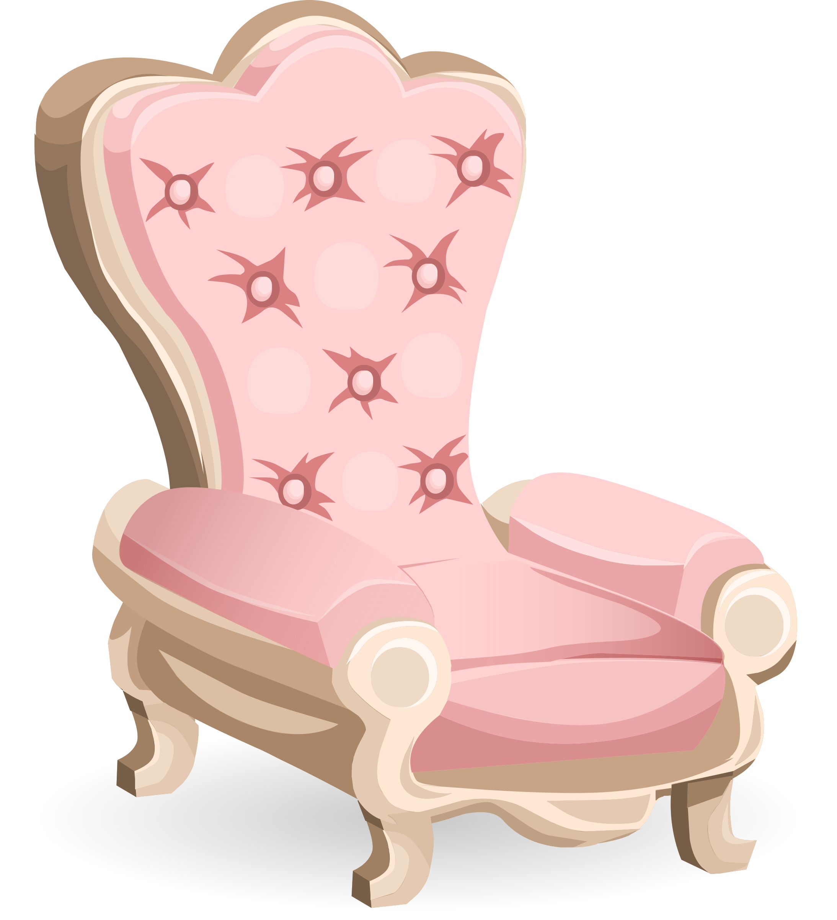
Chair

Slide 3
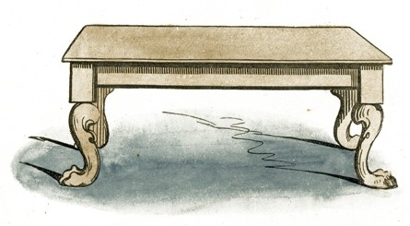
Table

Slide 4

Picture

Slide 5

Flower vase

Slide 6
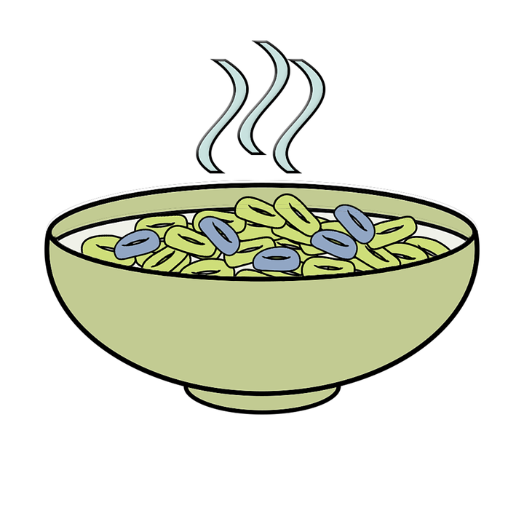
Bowl

Slide 7
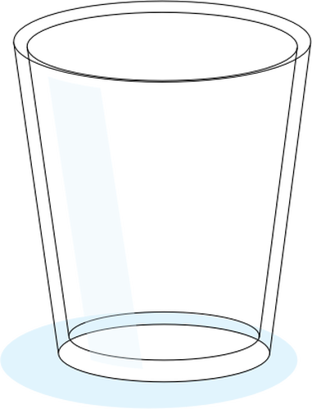
Glass

Slide 8
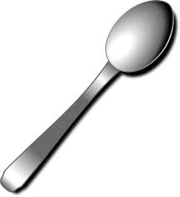
Spoon

